Slide 1
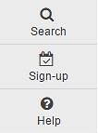
Sign-Up Tool

Slide 2
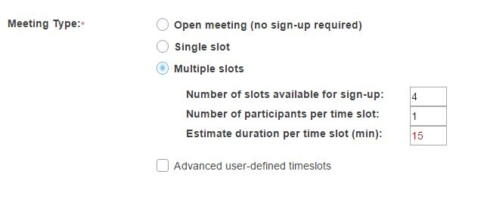
Sign-Up meeting types
There are three types of events or meetings:
Open meetings
Single slot meetings
Multiple slot meetings

Slide 3
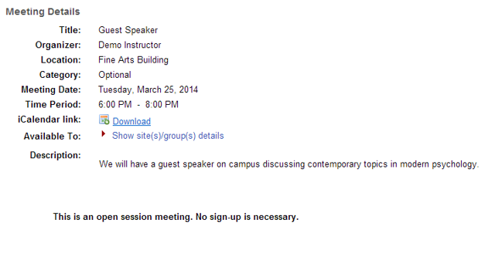
Open meetings
This option creates a single timeslot for an event or meeting, serving as an announcement. No attendance list is kept, so participants who plan to attend are not required to sign up.

Slide 4
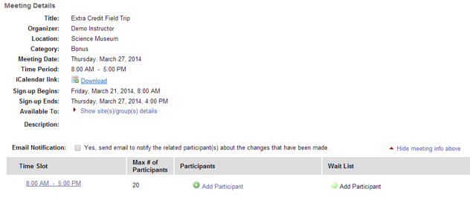
Single slot
A single timeslot is created, an attendance list is maintained, and the number of participants can be limited or unlimited. Participants are required to sign up in order to appear on the attendance list.

Slide 5
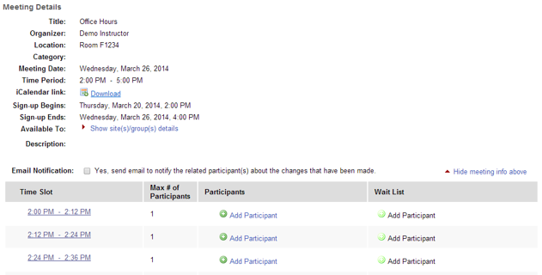
Multiple slots
A single time span can be divided into any number of timeslots of equal length, under a single meeting name. Participants are required to sign up in order to appear on the attendance list. The resulting series of timeslots can be removed or modified individually.

Slide 6
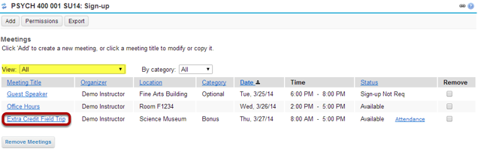
View of meetings in Sign-Up
The Sign-up tool displays the list of meetings.
Click on a meeting title to brings up its meeting details.

Slide 7
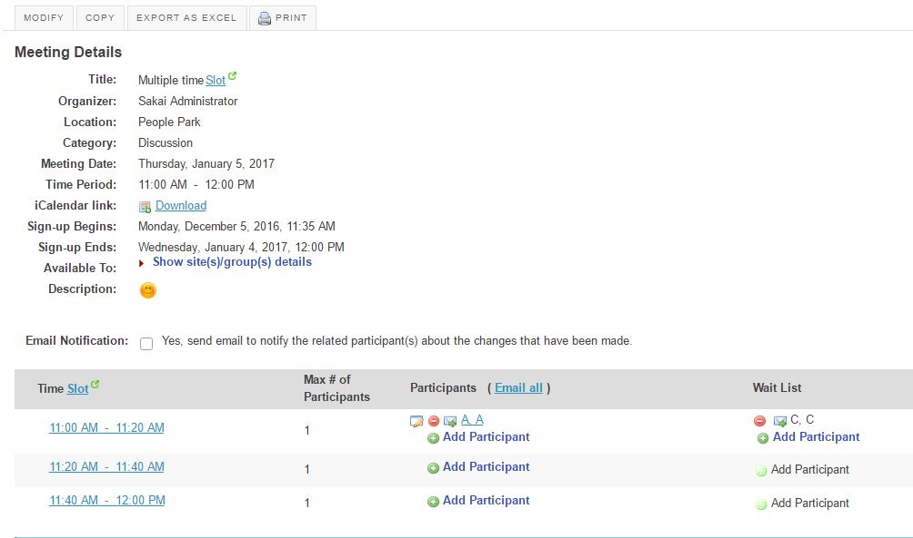
Meeting details
Detailed settings and timeslots, for a particular meeting, are listed here.
The organizer view shows those signed up and those on the waitlist.

Slide 8
Create a meeting
Click Add the meeting information screen will appear where you can enter all of the information for your meeting.
Select begin and end times for sign-up.
Enter the point at which the meeting should be opened for sign-up. Before then, participants will not have an active Sign-up button next to a meeting entry.
Number of participants
Options to choose between Max number (in which case, enter the number of participants allowed) and Unlimited.

Slide 9
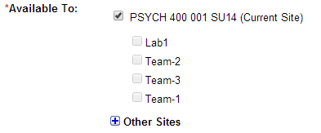
Specify meeting availability
This field allows you to determine who can sign up for the meeting. You can limit sign-up to members of a group or extend the sign-up offer to the membership of other sites, by selecting the appropriate checkboxes.

Slide 10
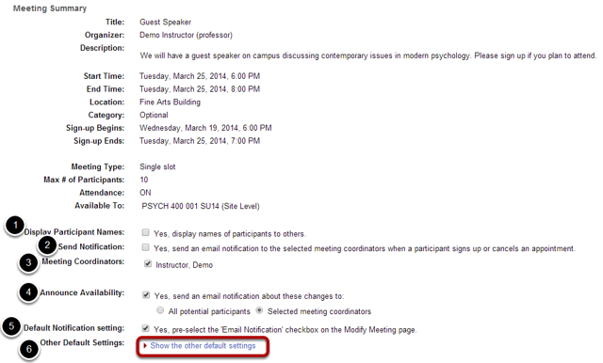
Review settings and select notification preferences

Slide 11
Notification and Attachments
Send notification: Check the appropriate box to manage email notifications when participants sign up or cancel.
Default Notification setting: "Yes" means that the notification box will be selected on the modify meetings page.
Click the Add Attachments button if you would like to browse for and attach a file to your meeting.

Slide 12
Participants sign-up for meetings
Click on a meeting title.
Click Sign Up (or) Click the button labeled Sign Up beside the timeslot you want.
If the meeting is full and your instructor has given the Wait List option, you will be able to add your name to the Wait List by clicking Join Wait List.
If space becomes available, you will be added to the list of attendees, and notified by email.
If your instructor has allowed, you will see a comment field where you can type a message, which is seen only by the instructor.

Slide 13
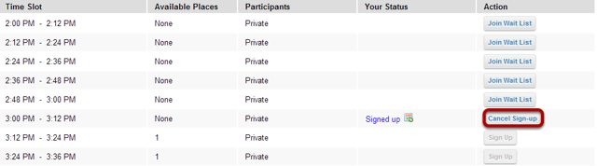
Participants sign-up for meetings
You may cancel any appointment you have signed up for, within the time period allowed by your instructor, by clicking the Cancel Sign-up button.

Slide 14
Export meeting data
The Export operation provides a rich set of data, in spreadsheet form, for a set of meetings or for a single meeting, including the list of those who have signed up.
The “.xls” file thereby created can be opened in Excel or some other spreadsheet application to show several sheets, as follows.
Attendees’ Schedules [for meeting organizers]: a datasheet with columns that show the meeting’s details, with one row for each meeting attendee signed up.
Events Overview: a chart of all meetings selected as they appear in the Meetings page.
For each meeting, a named sheet.
Chart showing the meeting title and details, plus a list of attendees [for users with that privilege], the wait list, and comments.

Slide 15
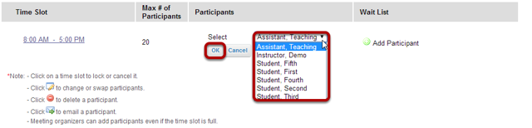
Manually add and remove users to meetings

Slide 16
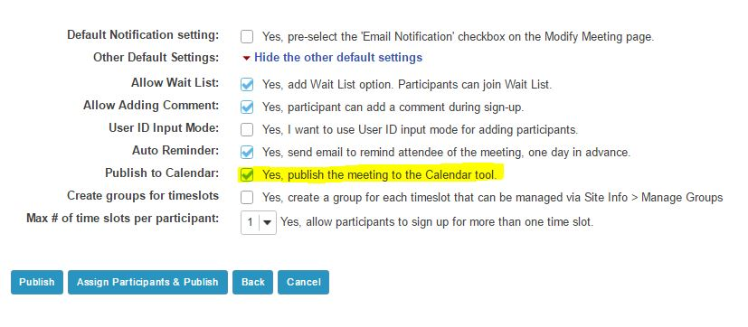
Add meetings to the site Calendar
Check Publish to Calendar when create meeting.

Slide 17
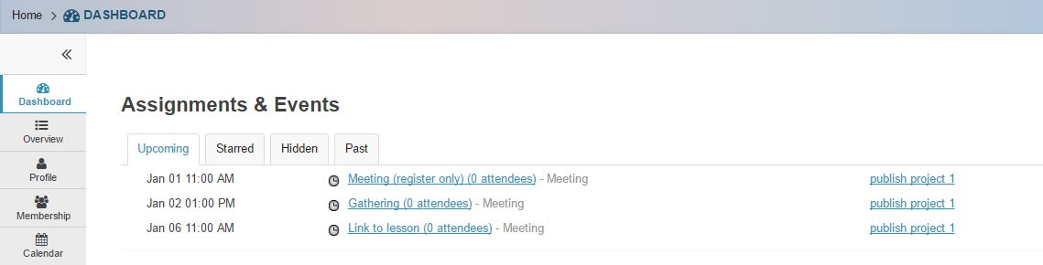
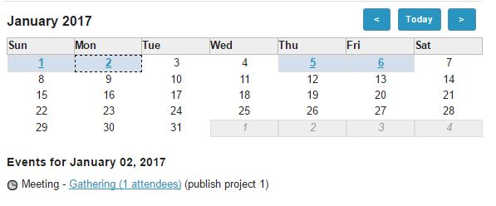
Dashboard and Calendar Notification

